Slide 1

College of space engineering and technology Technological University
People who changed the computer world
Completed by: student of group P1-17, Likhtorenko O.S.
Checked by the teacher: Fomicheva V.Yu.
Korolev, 2020

Slide 2
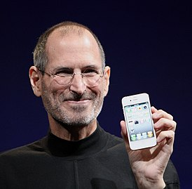
Steve Jobs
Steven Paul "Steve" Jobs is an American entrepreneur, inventor, and industrial designer widely recognized as a pioneer of the information technology era. Co-founder, Chairman of the Board of Directors and CEO of Apple Corporation. One of the founders and CEO of the Pixar film studio.
In the late 1970s, Steve Jobs and his friend Steve Wozniak developed one of the first personal computers with great commercial potential. The Apple II computer became the first mass product of Apple, created at the initiative of Steve Jobs. Jobs later saw the commercial potential of a mouse-driven graphical interface, which led to the Apple Lisa computers and, a year later, the Macintosh (Mac).
Jobs has received public recognition and a number of awards for his influence on the technology and music industries. He is often called the “visionary” and even the “father of the digital revolution”. Jobs was a brilliant speaker and took innovative product presentations to the next level, turning them into engaging shows. His instantly recognizable figure in a black turtleneck, frayed jeans and trainers is surrounded by a kind of cult.

Slide 3
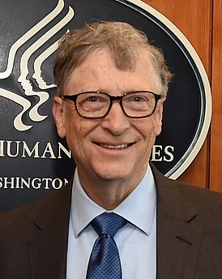
Bill Gates
William Henry Gates III, better known as Bill Gates, is an American entrepreneur and public figure, philanthropist, one of the founders (together with Paul Allen) and the former largest shareholder of Microsoft. Until June 2008, he was the head of the company, after leaving the post, he remained in the position of its non-executive chairman of the board of directors. He is also Co-Chair of the Bill & Melinda Gates Foundation, Member of the Board of Directors of Berkshire Hathaway, and CEO of Cascade Investment.
In the period from 1996 to 2007, from 2009 to 2016 - the richest person in the world according to Forbes magazine. As of November 10, 2020, Bill Gates' fortune is estimated at $ 119.1 billion. He ranks second in the ranking of the richest people on the planet, behind Amazon founder Jeff Bezos.
Bill Gates is one of the world's largest donations to charity: between 1994 and 2010, he donated over $ 28 billion to the Bill & Melinda Gates Foundation. In February 2010, Gates made an offer to all billionaires to donate half of their fortunes to charity.

Slide 4
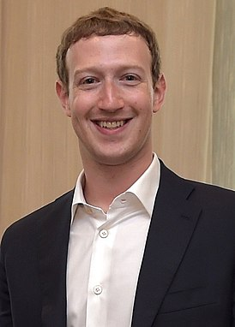
Mark Zuckerberg
Mark Elliot Zuckerberg is an American computer programmer, Internet technology entrepreneur, dollar billionaire. According to Forbes, in 2018 he was on the 5th place in the list of the richest people in the world with a fortune of $ 71 billion, one of the developers and founders of the social network Facebook. Head of Facebook Inc.
If Vint Cerf created the technology that allows people around the world to communicate freely with each other, then Mark Zuckerberg - the founder of the largest modern social network Facebook - took this communication to a whole new level. Although Zuckerberg can hardly be called the inventor of social networks, it is he who is responsible for their current crazy popularity all over the world (according to statistics, 99% of the inhabitants of the Russian Internet use social networks).
Zuckerberg created Facebook in 2004 while studying at Harvard University and initially the resource was intended only for students of this university. Today, the social network unites almost a billion people and is not only a place for people to communicate with each other, but also a powerful catalyst for social and political events. As many believe, it was this social network that played an important role in the "Arab Spring".

Slide 5
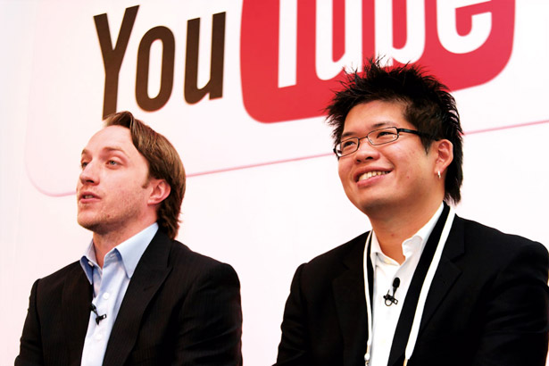
Chad Hurley and Steve Chen
Chad Meredith Hurley (born January 24, 1977) is an American media mogul, co-founder and former CEO of the video-sharing websites YouTube and MixBit. In June 2006, he was voted 28th on Business 2.0's "50 People Who Matter Now" list. In October 2006, he and Steve Chen sold YouTube for $1.65 billion to Google. Hurley worked in eBay's PayPal division—one of his tasks involved designing the original PayPal logo—before starting YouTube with fellow PayPal colleagues Steve Chen and Jawed Karim. Hurley was primarily responsible for the tagging and video-sharing aspects of YouTube.
Steven Shih Chen born August 25, 1978 is an American Internet entrepreneur who is one of the co-founders and previous chief technology officer of the video-sharing website YouTube. After having co-founded the company AVOS Systems, Inc. and built the video-sharing app MixBit, he joined Google Ventures in 2014.
Founders of the super popular YouTube. The project was founded in February 2005 by three former Paypal employees. They used Flash Video (flv) technology, which allows for good recording quality with a small amount of data transfer. The project has become a good entertainment tool and, having formed its own community, according to statistics from the analytical company Alexa, it has surpassed the social network MySpace in popularity. In November 2006, YouTube was bought by Google for $ 1.65 billion. Chad was 28 and Steve was 27 when they founded YouTube.

Slide 6
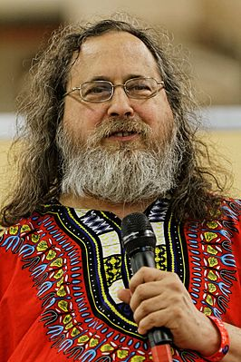
Richard Stallman
Richard Matthew Stallman is the founder of the free software movement, the GNU Project, the Free Software Foundation, and the League for Programming Freedom. Author of the concept of copyleft, designed to defend the ideals of the movement; he later embodied this concept with the help of lawyers in the GNU General Public License (GNU GPL) for software.
Formerly also a well-known programmer. Among the programs he authored are GNU Emacs, the GNU Compiler Collection (GCC), and the GNU Debugger (GDB). Since the mid-1990s, Stallman began to program significantly less, devoting himself to spreading the ideas of free software.
In 1983, Stallman formulated the principle of the free software movement: the user of the program should have the right to use it in any way, study the principle of the program, modify it according to his needs and distribute copies on his own. Best of all, these four freedoms have shown themselves on the Internet, without them the systems on the basis of which Google, Twitter, Facebook, Android, let alone Linux work, would not have been created.
In a broad sense, the ideas of Stallman and his followers have shaped the model of a democratic Internet community, in which the actions of each member are evaluated according to their value, and not according to social status.

Slide 7
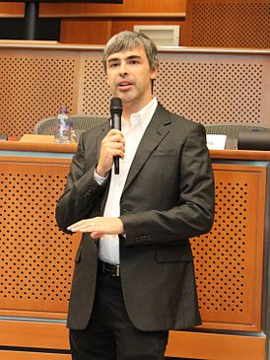
Larry Page
Lawrence Edward "Larry" Page is the developer and co-founder (with Sergey Brin) of the Google search engine.
Page is the chief executive officer (CEO) of Google's parent company, Alphabet. On April 4, 2011, he again became CEO of Google, succeeding Eric Schmidt, following his resignation as CEO of Google in August 2001. He announced his intention to retire a second time in July 2015 to become CEO. CEO of Alphabet, at the head of which Google's assets will be reorganized. Led by Page, Alphabet is committed to making significant strides across a variety of industries.
As of July 2020, Paige is the 10th richest person in the world, with a net worth of $ 67.1 billion.
Page is the inventor of PageRank, Google's most famous link ranking algorithm. Page received the 2004 Marconi Prize.

Slide 8
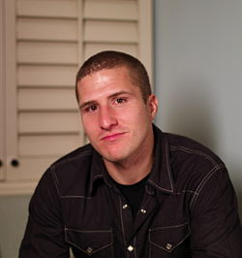
Shawn Fanning
Shawn Fanning is an American programmer, Internet entrepreneur, creator of the file-sharing computer network Napster, founder of Snocap, B2B companies.
Sean Fanning, an 18-year-old student at Northeastern University in the United States, revolutionized the media industry with the creation of the world's first file-sharing network, Napster, in 1999.
Fanning developed a program for free downloading and downloading music in mp3 format together with future IT businessman Sean Parker. Napster caused a stir - in a few days the network's audience grew to 15 thousand users. As a result, like a number of other IT innovators, Fanning left the university and devoted himself entirely to the project.
However, as one would expect, copyright holders did not share the joy of users about free content. In 2001, Fanning had to shut down Napster due to copyright infringement lawsuits.
Despite this, Napster pioneered the creation of peer-to-peer networks and torrent trackers, many of which are involved in copyright lawsuits, but remain popular with users. In 2002, the Massachusetts Institute of Technology named Fanning in the top 100 innovators under the age of 35.

Slide 9
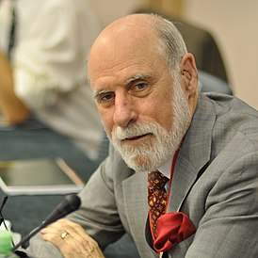
Vinton Cerf
Vinton Gray “Vint” Cerf is an American computer scientist, one of the developers of the TCP / IP protocol stack, often called the “father of the Internet”.
The creation of a worldwide network has changed the idea of ​​people about the possibilities of exchanging and searching for information and ways of communicating with each other. Vinton Cerf is rightfully considered one of the "fathers of the Internet". With Robert Kahn in the 1970s, Cerf first worked on the prototype of the Internet, the ARPANET for the military, and then created the TCP / IP protocol specifications, which became one of the cornerstones of the "network of networks."
Cerf did not move away from the development of his brainchild afterwards. He was instrumental in founding ICANN, the Internet regulator, and in 2005 became Vice President and Chief Internet Evangelist of Google Corporation.
In December 1997, Bill Clinton, then President of the United States, awarded Cerf and Kahn the National Medal of Technology and Innovation for the creation and development of innovation. In addition, in 2004, their work on creating Internet protocols was awarded the Turing Prize, which is a kind of Nobel Prize for computer science.

Slide 10
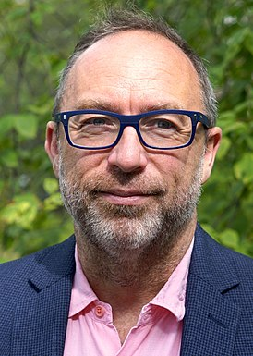
Jimmy Wales
Jimmy Donal Wales is an American and British Internet entrepreneur, ideologue of the wiki concept, founder of Wikipedia, chairman of the Wikimedia Foundation (2003-2006). Since Summer 2011 - Honorary Chairman of the Wikimedia Foundation; Director of Wikia, Inc. Laureate of the Niels Bohr Gold Medal. Received British citizenship on 13 September 2019.
Schoolchildren, students and simply curious people could not imagine the modern world without Wikipedia - a free online encyclopedia that made knowledge truly accessible. The face of the encyclopedia and its co-founder is Jimmy "It's Time to Pay" Wales, remembered by users for the banners on the pages of the encyclopedia, calling on readers to donate money to the development of Wikipedia.
However, in 2001, when Wikipedia first appeared, even the creators could not imagine that their project would change the idea of ​​mankind about methods of solving complex problems, popularizing the concept of "crowdsourcing".
Initially, the resource was an appendage to the Nupedia project, an online encyclopedia compiled exclusively by experts. However, the platform for "draft articles" turned out to be much more successful than the original - and it was Wales who turned out to be the person who understood the prospects of this approach.
Wikipedia is often criticized for inaccuracies in articles, illegibility in the choice of sources of information, and weak editorial policy. All this is true, and users who use the texts of the encyclopedia for serious work need to be careful. But it cannot be denied that Wikipedia has been successfully satisfying and feeding mankind's thirst for knowledge for a decade, in fact, pushing into the shadows other types of encyclopedias.

